Slide 1
Who is Mrs. Corrao?

Slide 2
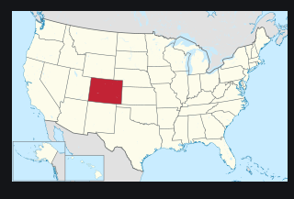
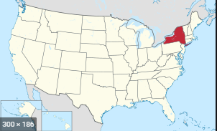
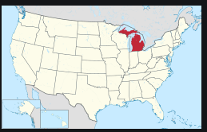
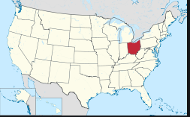
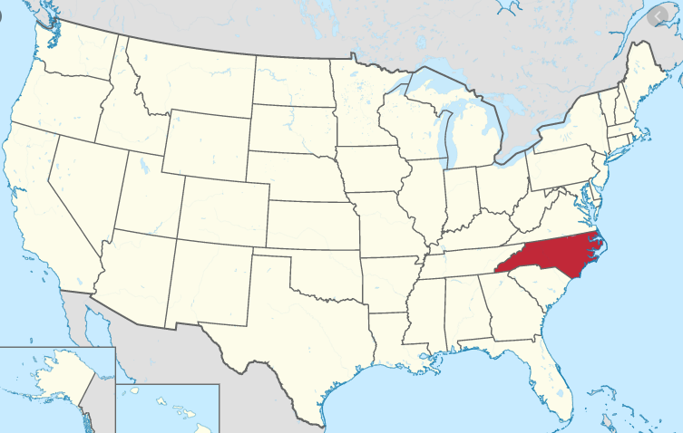
Geography
Fort Collins, Colorado
Rochester, New York
Ann Arbor, Michigan
Dayton, Ohio
Charlotte, North Carolina

Slide 3
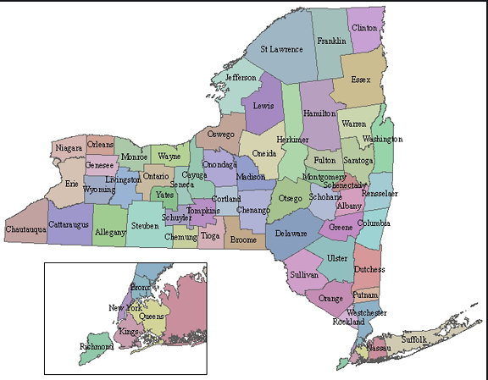
New York, not New York City!

Slide 4
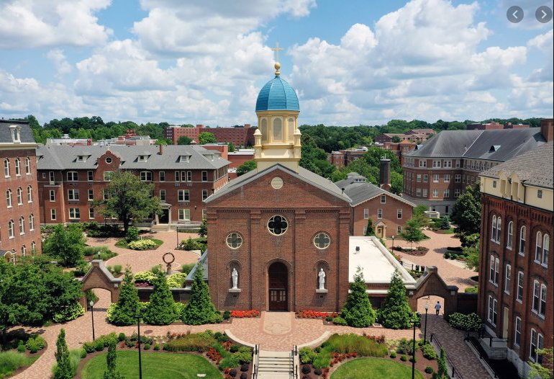
College

Slide 5
My Family

Slide 6
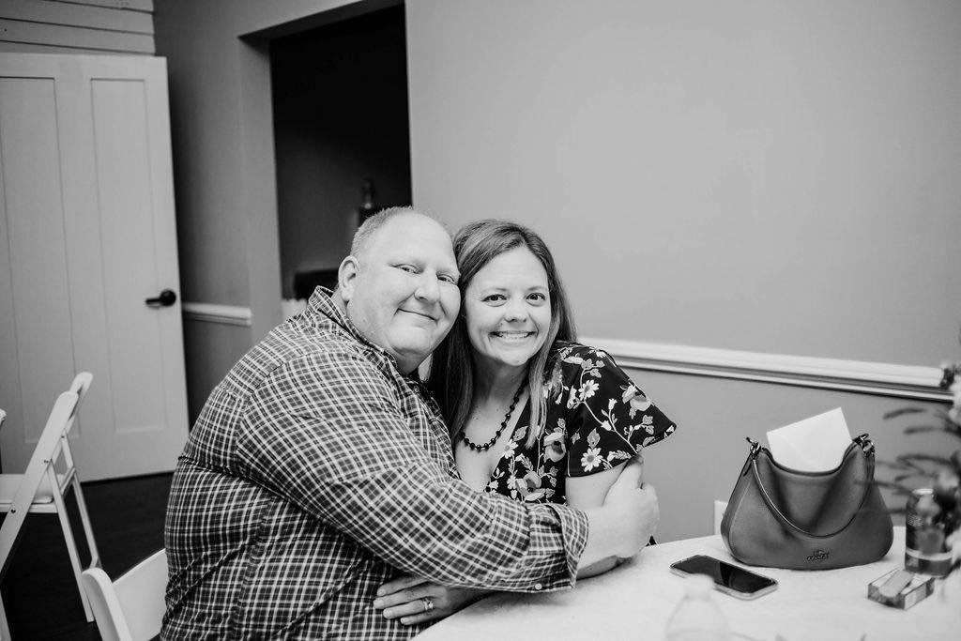
This is my husband, Steve
We’ve been married for 12 years.
He owns his own real estate company

Slide 7
This is my son Dylan
He is going into fifth grade.
He LOVES soccer!

Slide 8
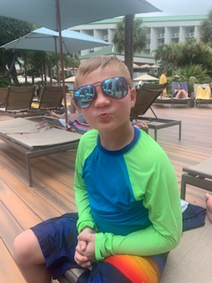
This is my youngest son Hudson
He is going into third grade.
He also loves soccer and wrestling

Slide 9
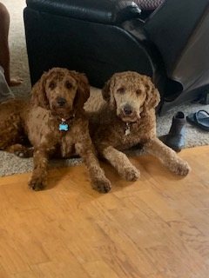
These are the Double Doodles
Annie (on the right) is 1 year old.
Stryker (on the left) is 1 ½ years old.

Slide 10
My life outside of school

Slide 11
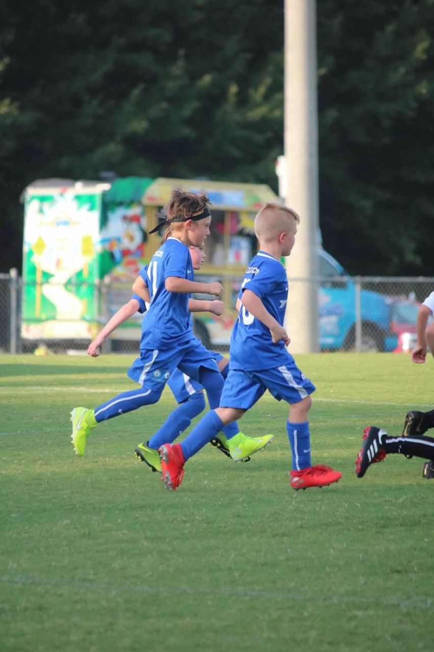
Soccer Soccer Soccer
Both boys play travel soccer, so we are always on the fields!

Slide 12
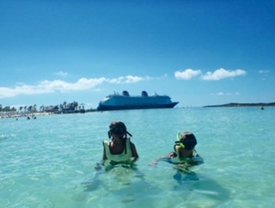
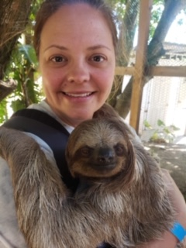
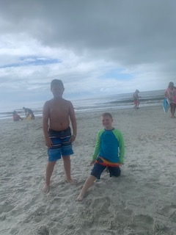
Travel
My family and I love to travel on school breaks!

